Slide 1
Level 2: Chapter 1 Azure Data Factory

Slide 2
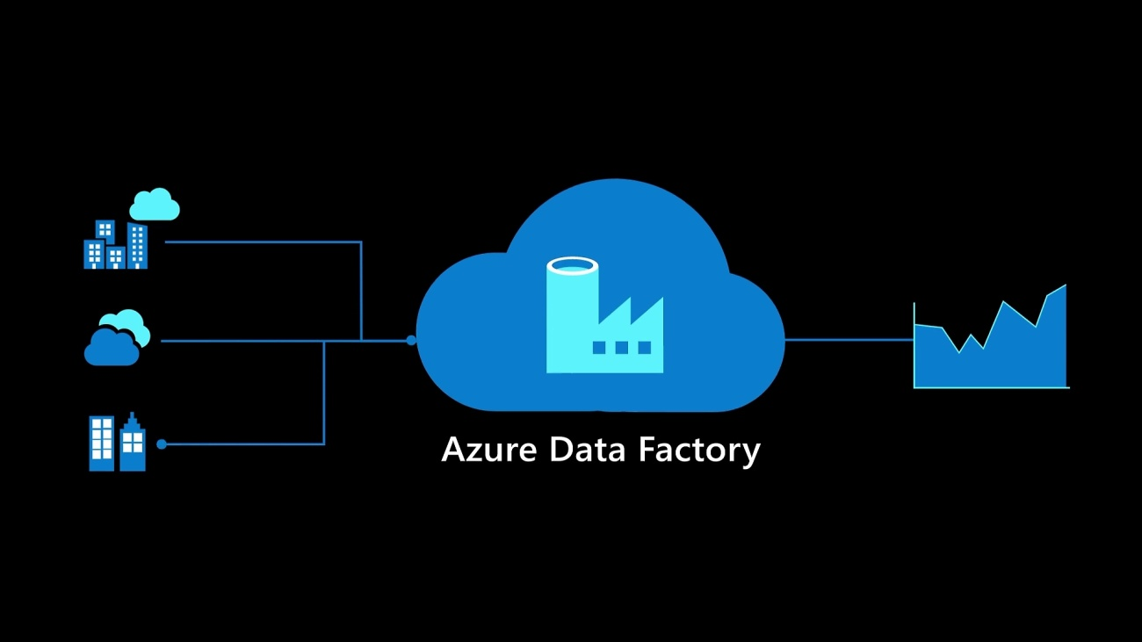
What is Azure Data Factory?
Integrate all your data with Azure Data Factory, a fully managed, serverless data integration service. Visually integrate data sources with more than 90 built-in, maintenance-free connectors at no added cost.
Easily construct ETL (extract, transform, and load) and ELT (extract, load, and transform) processes code-free in an intuitive environment or write your own code. Then deliver integrated data to Azure Synapse Analytics to unlock business insights.

Slide 3
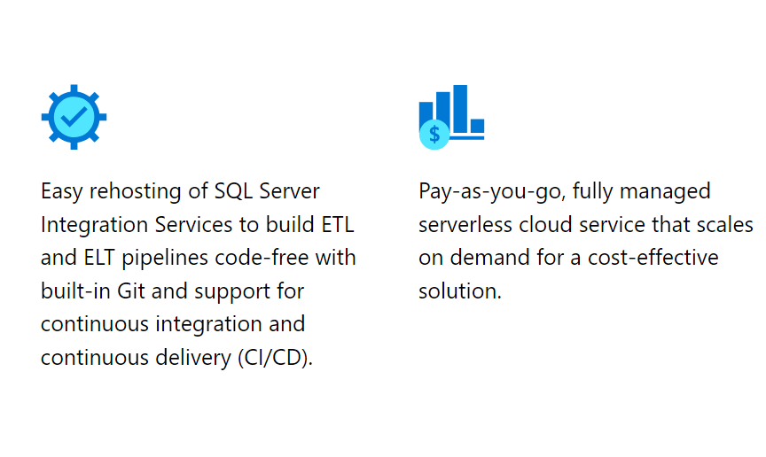
Azure Data Factory key characteristics

Slide 4
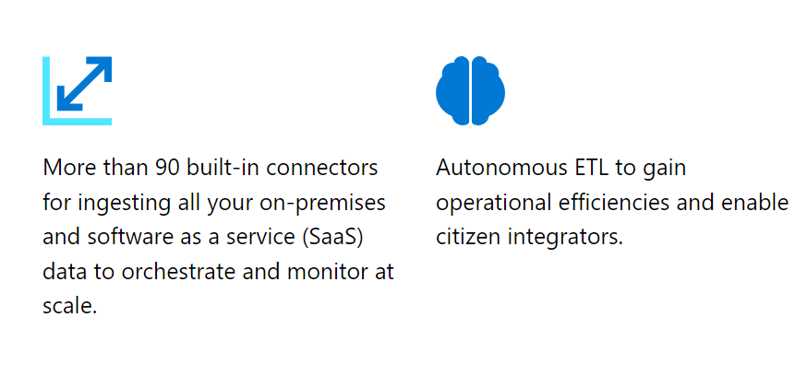
Azure Data Factory key characteristics

Slide 5
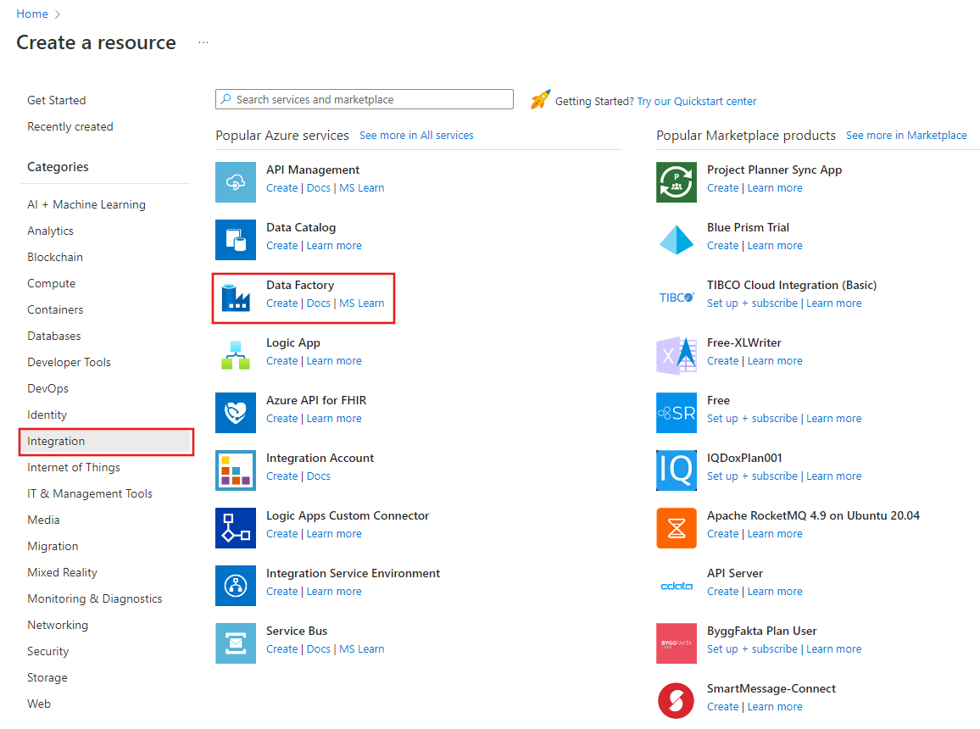
Copy data from Azure Blob storage to SQL using Copy Data tool - Azure Data Factory | Microsoft Learn https://learn.microsoft.com/en-us/azure/data-factory/tutorial-copy-data-tool
Create a data factory

Slide 6
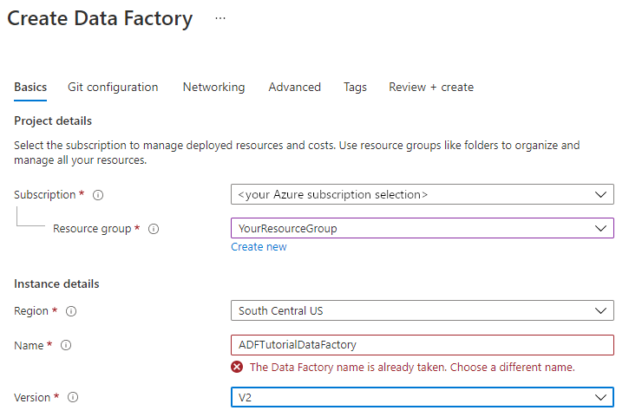
Create a data factory

Slide 7
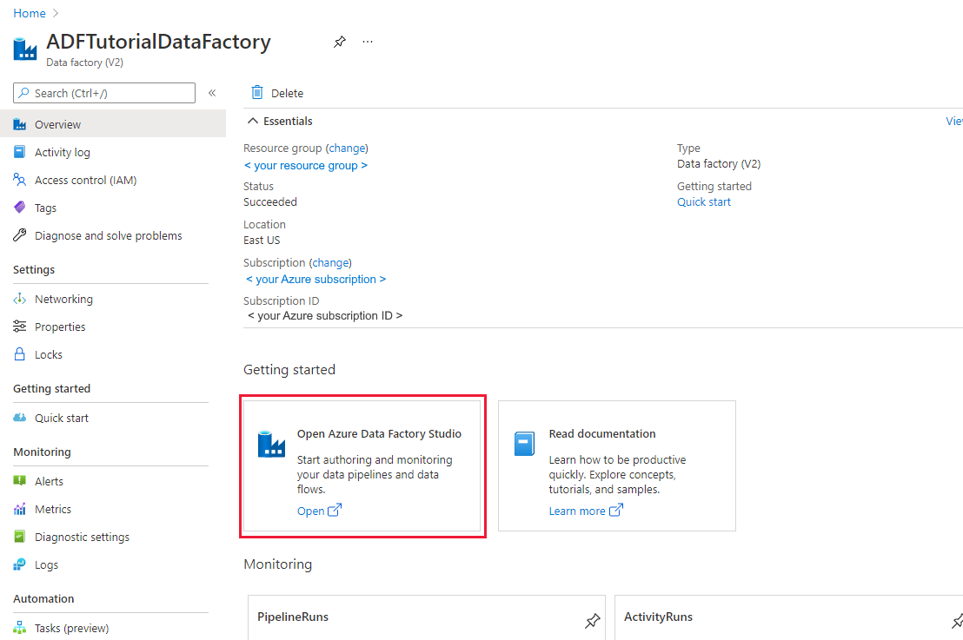
Create a data factory

Slide 8
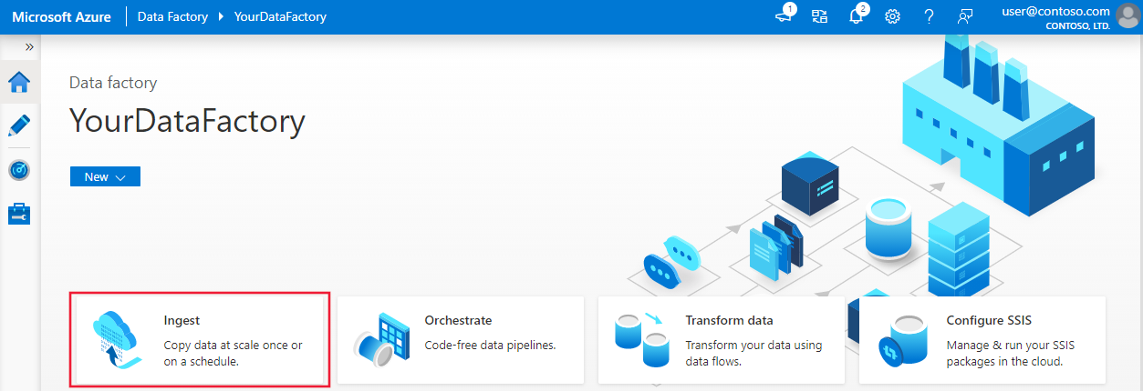
Create a data factory

Slide 9
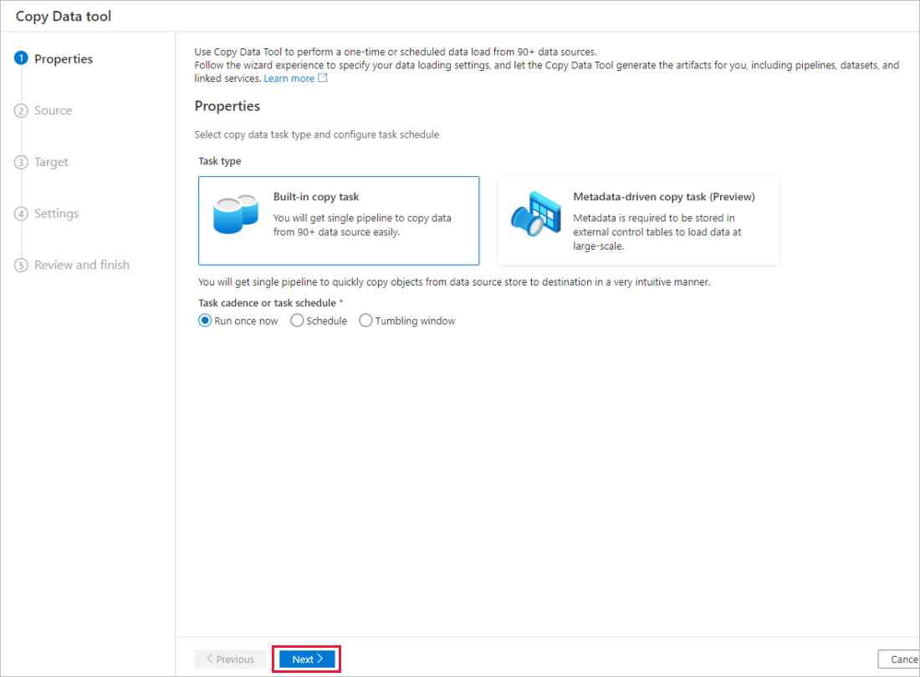
Create a data factory

Slide 10
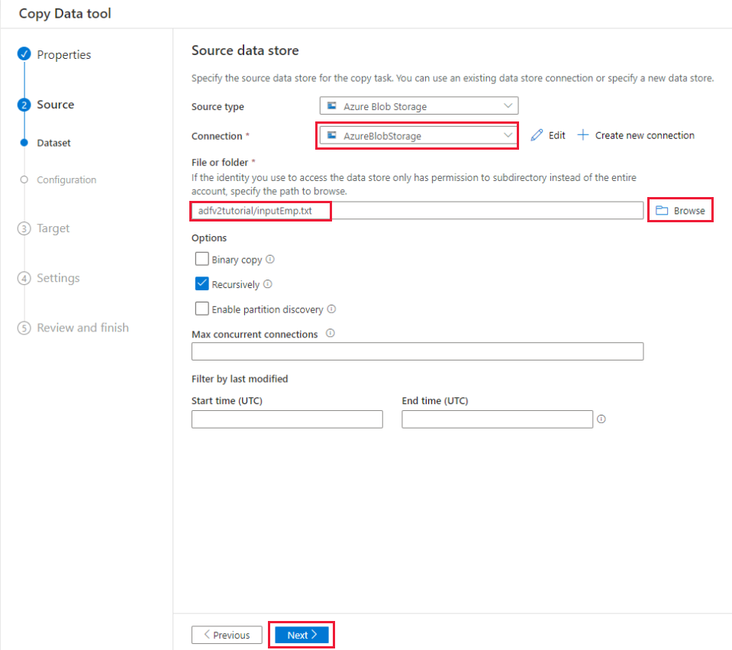
Create a data factory

Slide 11
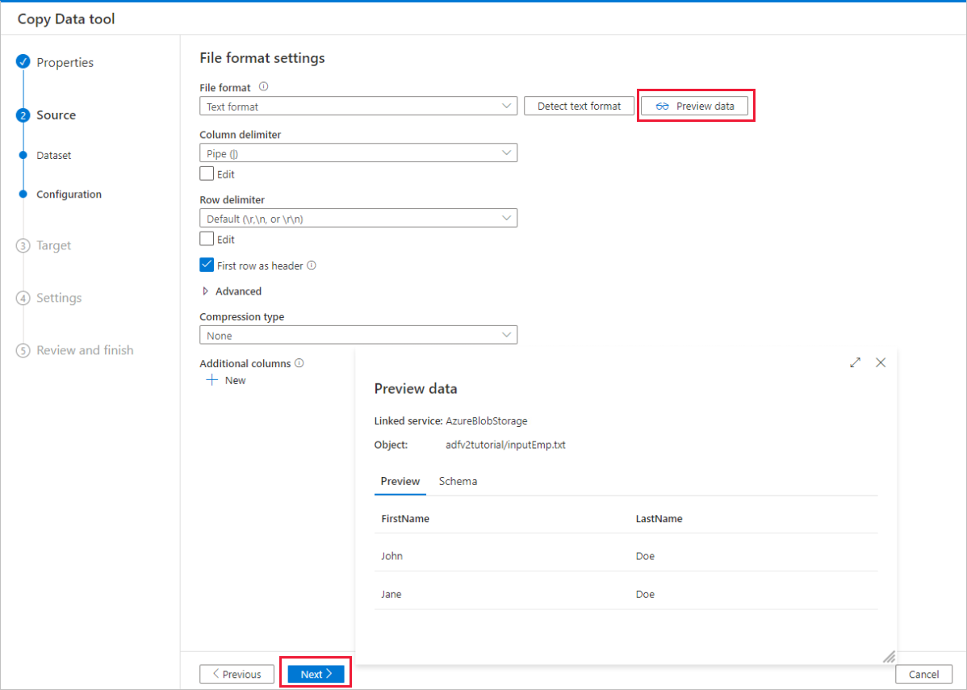
Create a data factory

Slide 12
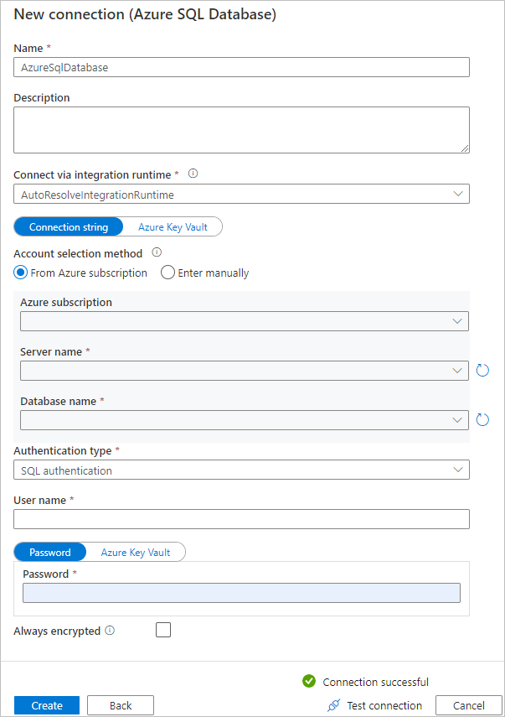
Create a data factory

Slide 14
Thanking you !!!
Any Question !!!!

